Slide 1


DATA ANALYSIS

Slide 2


Today's Agenda
Project recap
Problem
The Analytics team
Process
Insights
Summary

Slide 3

Social Buzz was founded by two former engineers from a large social media conglomerate, one from London and the other from San Francisco.
They are expecting the following:
- An audit of their big data practice.
- Recommendations for a successful IPO.
- An analysis of their content categories that highlights the top 5 categories with the
largest aggregate popularity .
Project Recap

Slide 4

Over the past 5 years, Social Buzz has reached over 500 million active users each month. Every day over 100,000 pieces of content, ranging from text, images, videos and GIFs are posted.
What should we do?
- An analysis of their content categories that highlights the top 5 categories with the largest aggregate popularity
Problem

Slide 5



Andrew Fleming
Chief Technical Architect
The Analytics team
Marcus Rompton
Senior Principle
Ann Mariya Saji
Data Analyst

Slide 6
Data understanding
Process
1
Data cleaning
2
Data modeling
3
Data analysis
4
5
Uncover insights

Slide 7
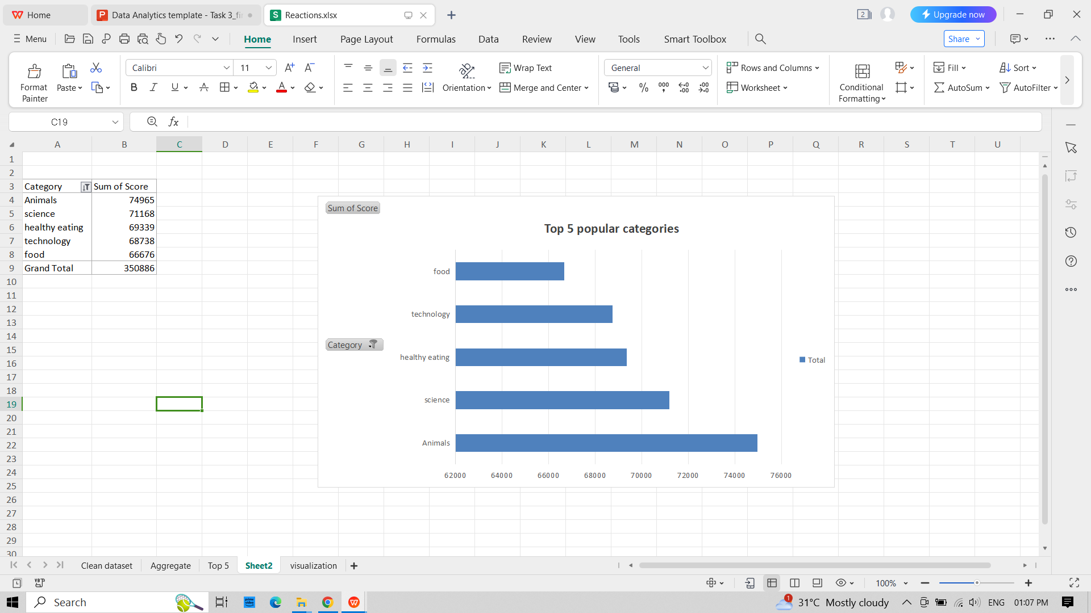

Slide 8

Insights
16
1897
JANUARY
unique categories
number of reactions to the most popular category
month with the most number of posts

Slide 9

We have cleaned , analysed the data and found the 5 popular categories of content. The result is represented as a bar chart.
Summary

Slide 10

Thank you!
ANY QUESTIONS?

